Slide 1
Resist the virus
Gemaakt door:
Niels, Coen, Jason, Tijmen, Melissa en Bente

Slide 2
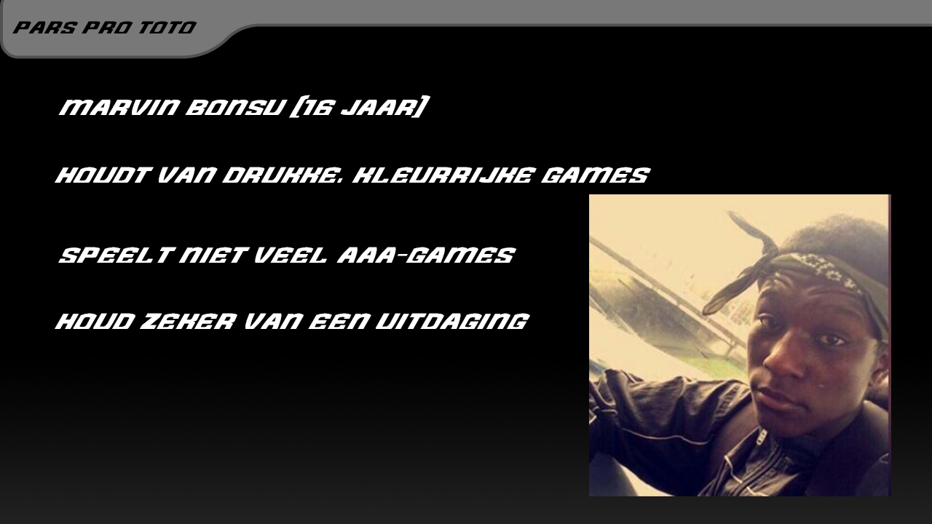

Slide 3
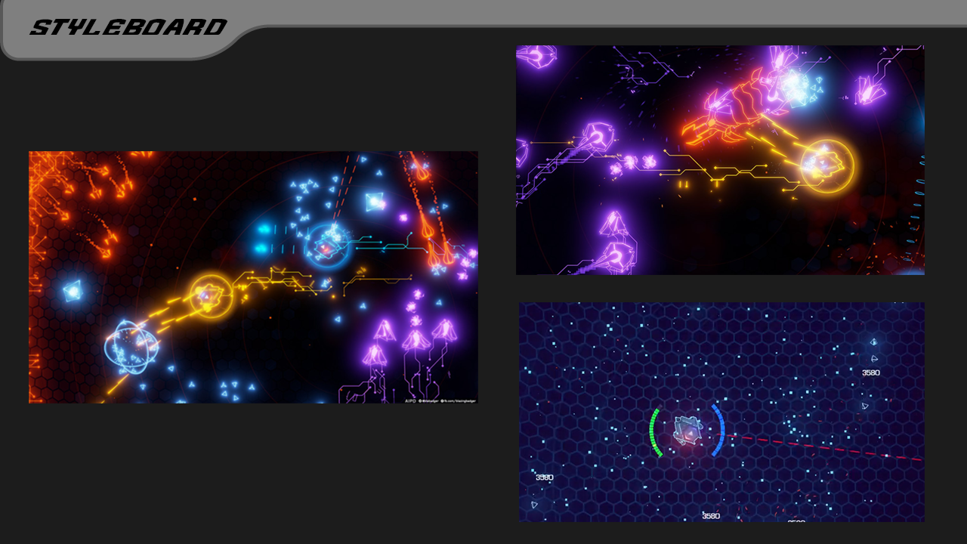

Slide 4
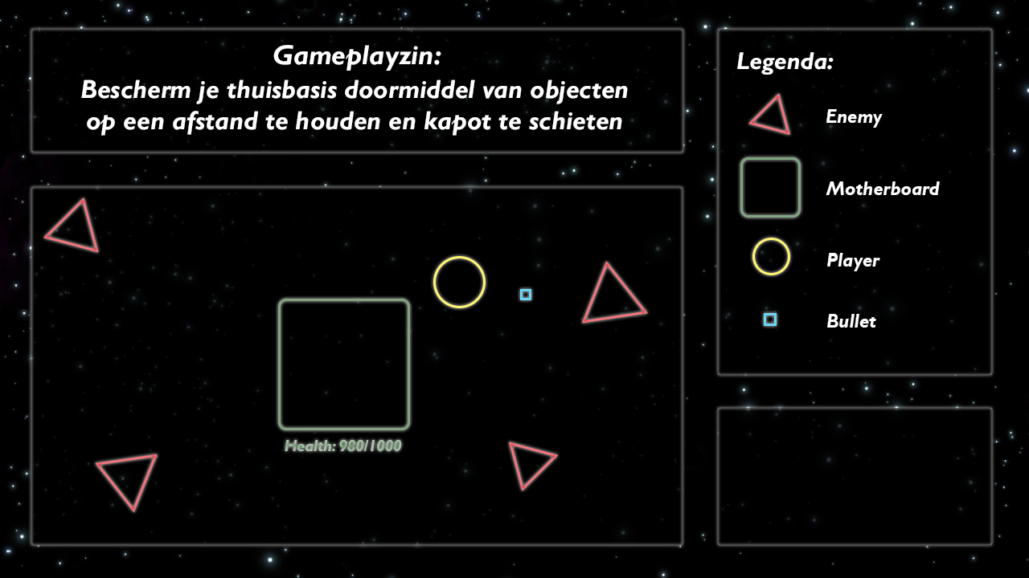

Slide 5
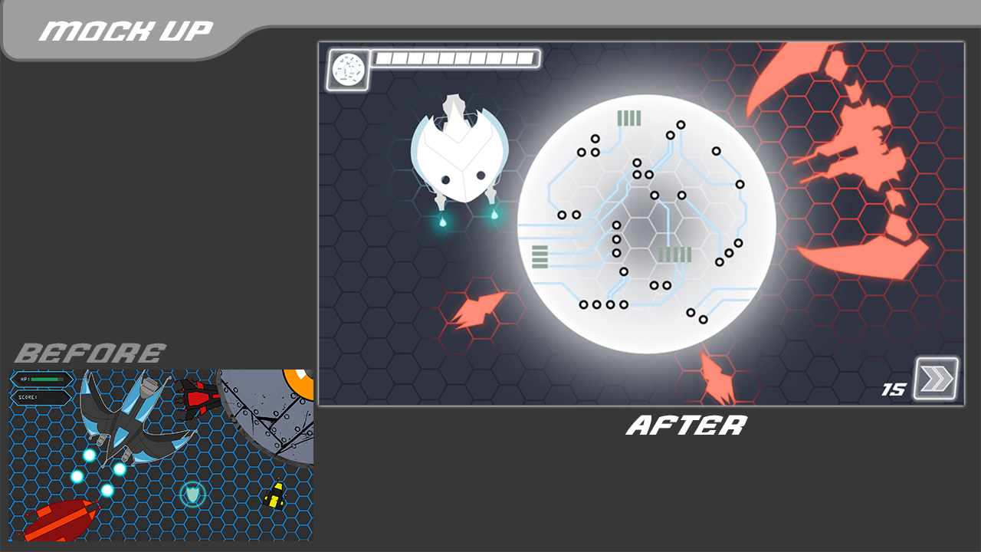
Feedback

Slide 6
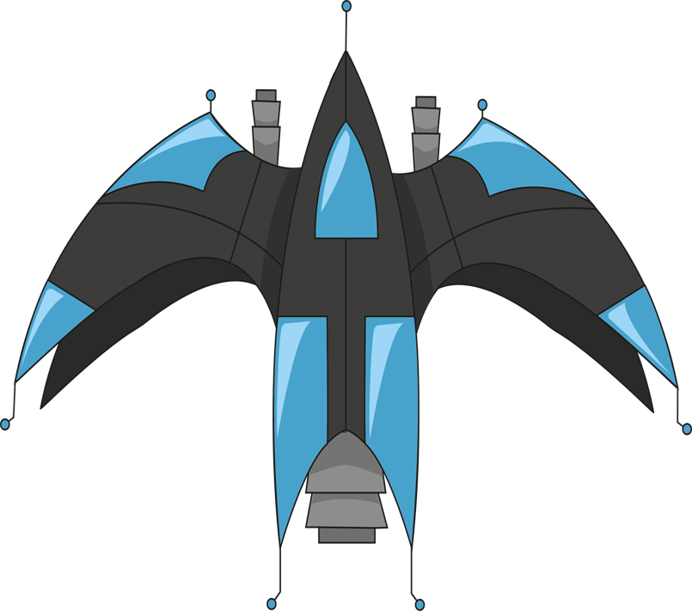



Player feedback

Slide 7



Enemy feedback

Slide 8






Slide 9
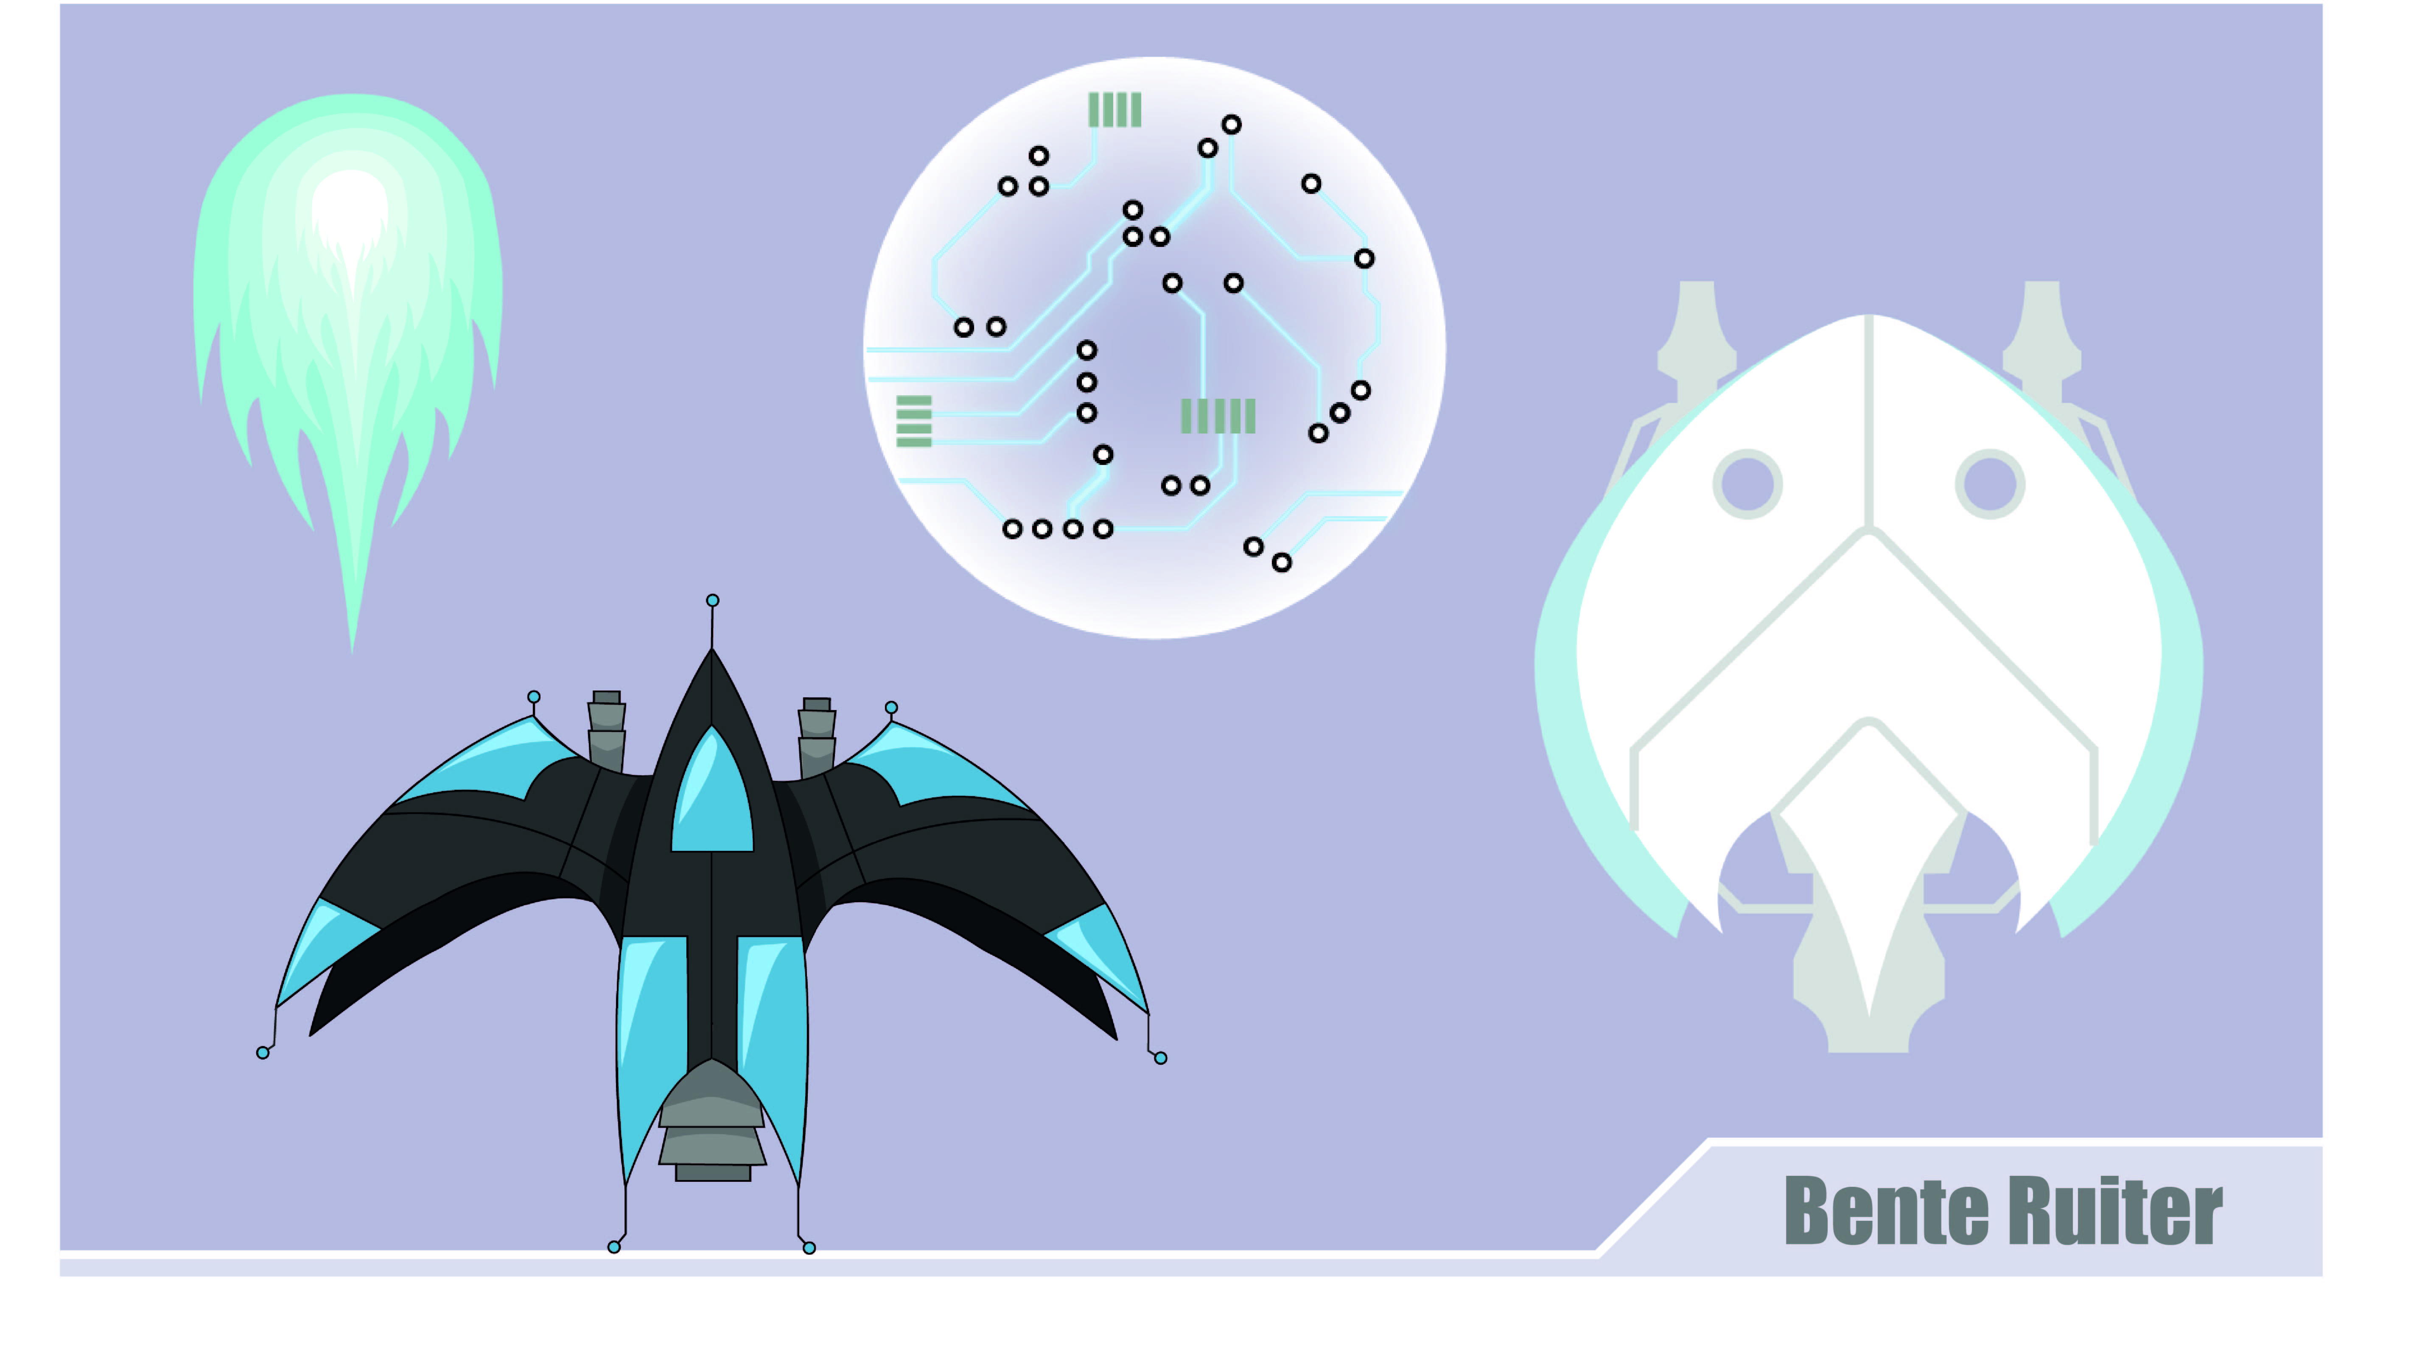

Slide 10
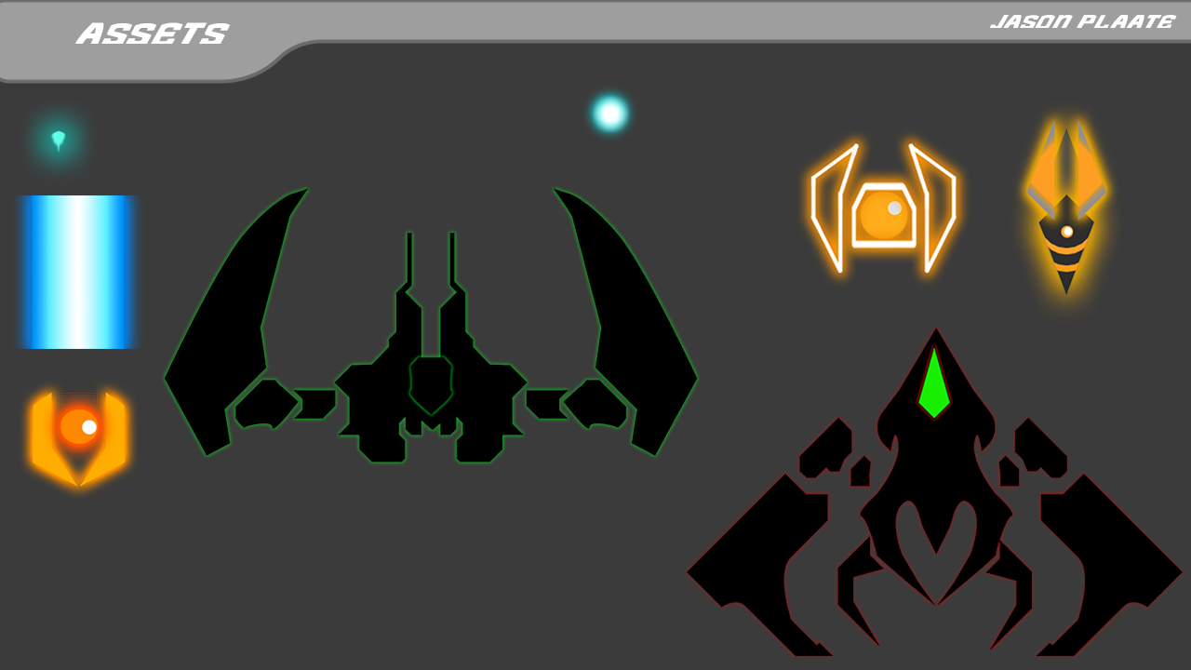

Slide 11
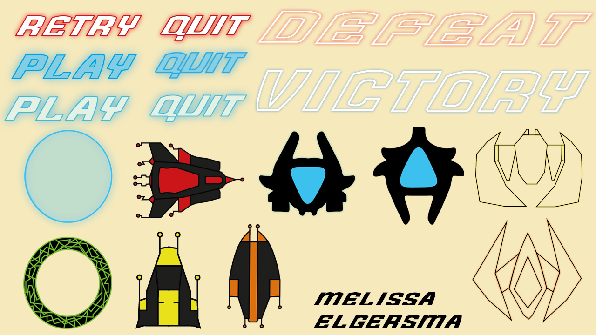

Slide 12
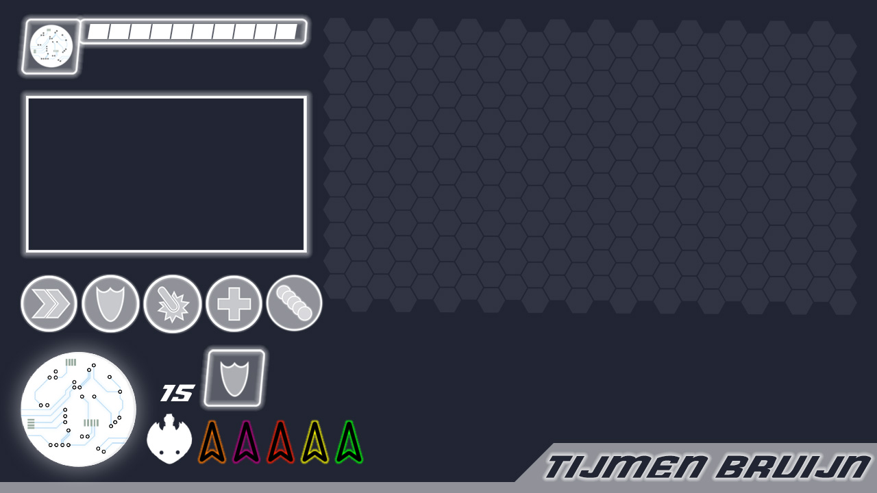
game

Slide 13
Game

